Slide 1
Capstone Project
Finding a Philadelphia Neighborhood Most Similar to Almagro, Madrid

Slide 2
Introduction
The project objective is to find a neighborhood in Philadelphia, PA, USA, that is most similar to Almagro, Madrid
The program is also applicable for finding a neighborhood in any city that is similar to some other target neighborhood.
The algorithm could be used by people who are planning to move to a new city and want to find a neighborhood that is most similar to a known neighborhood that they find desirable. T
The algorithm also incorporates real estate price data so that the user can compare similarity between neighborhoods and median housing prices to find a most optimal match for his/her particular situation.

Slide 3
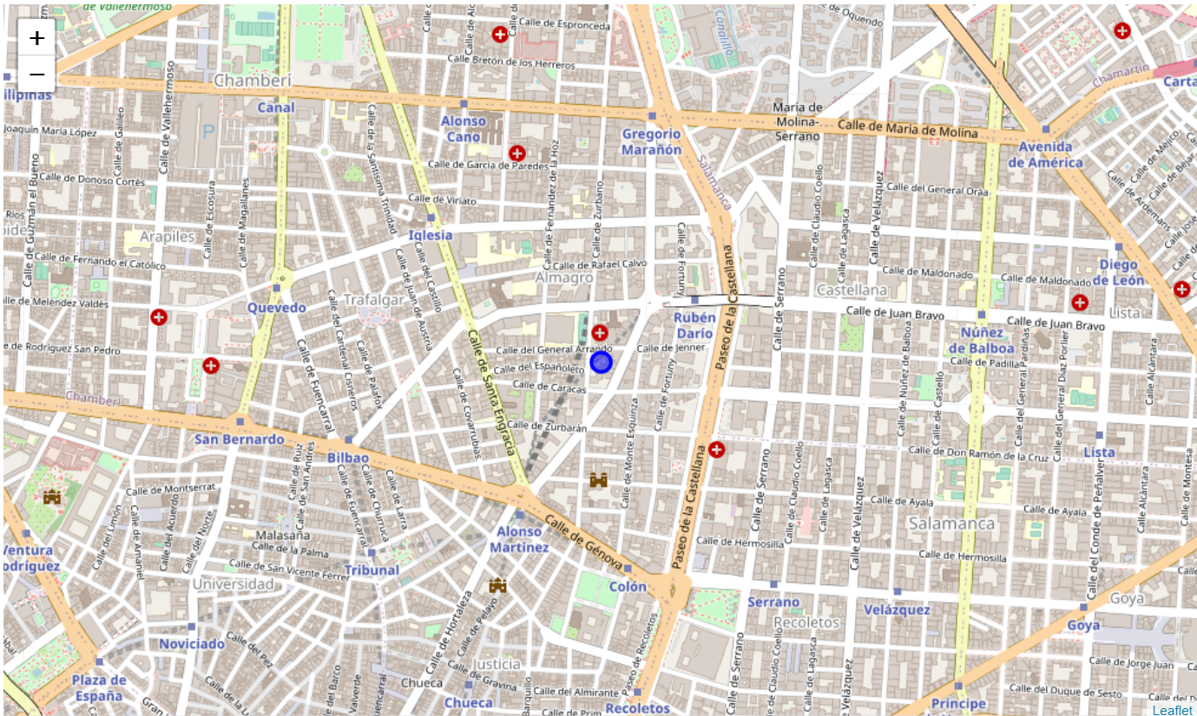
Target Neighborhood – Almagro, Madrid

Slide 4
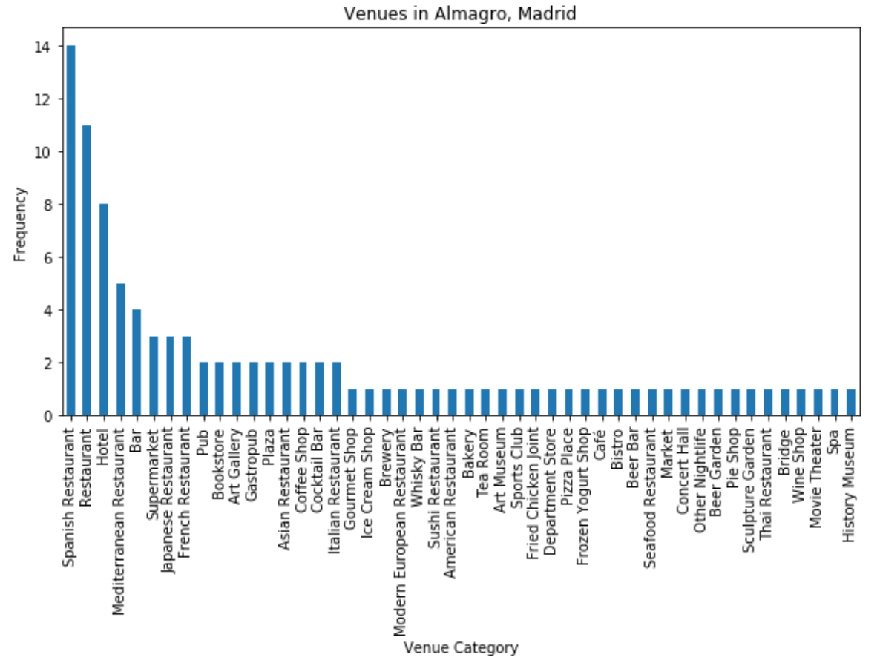
Venues Categories in Almagro, Madrid
Almagro has a high concentration and wide variety of restaurants. Spanish and Mediterranean restaurants are most common. There are also a good number of bars/pubs and hotels, and some art galleries.

Slide 5
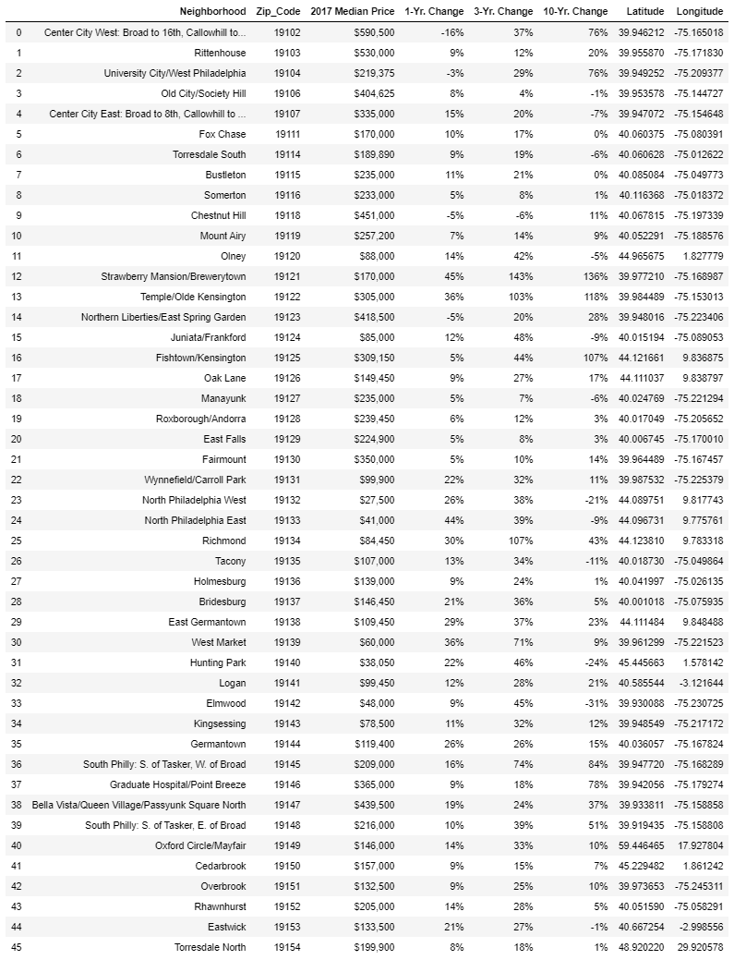
Dataframe of Philadelphia Neighborhoods for Analysis

Slide 6
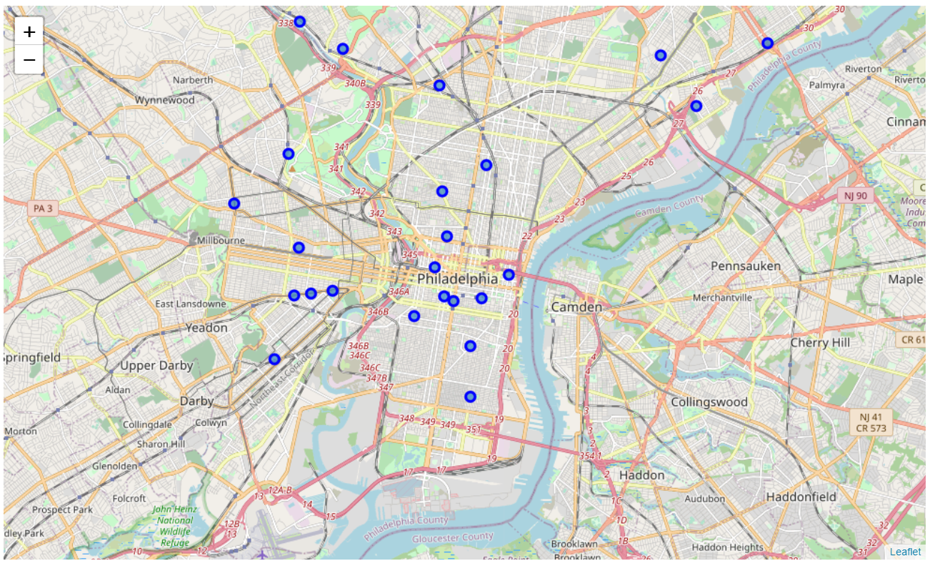
Locations of Philadelphia Neighborhoods

Slide 7
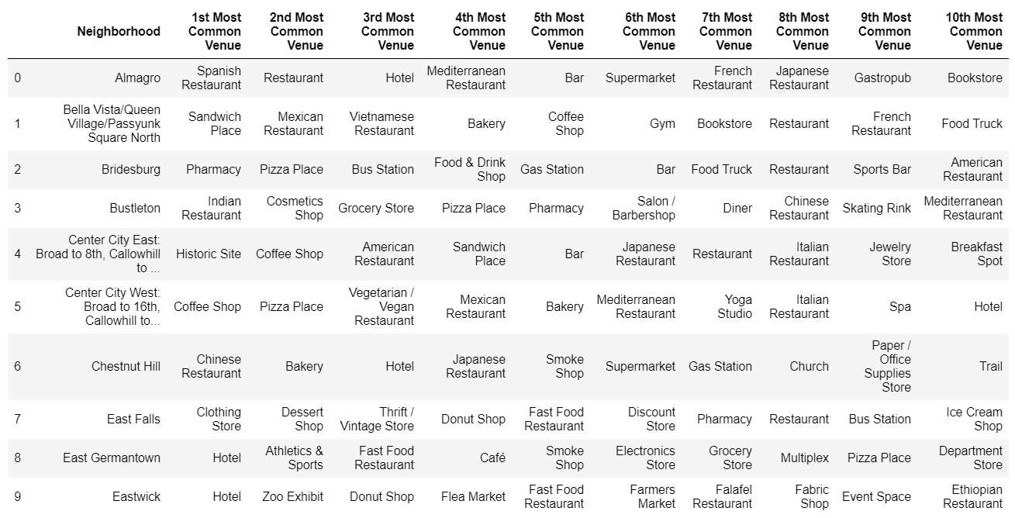
Most Common Venues by Neighborhood

Slide 8
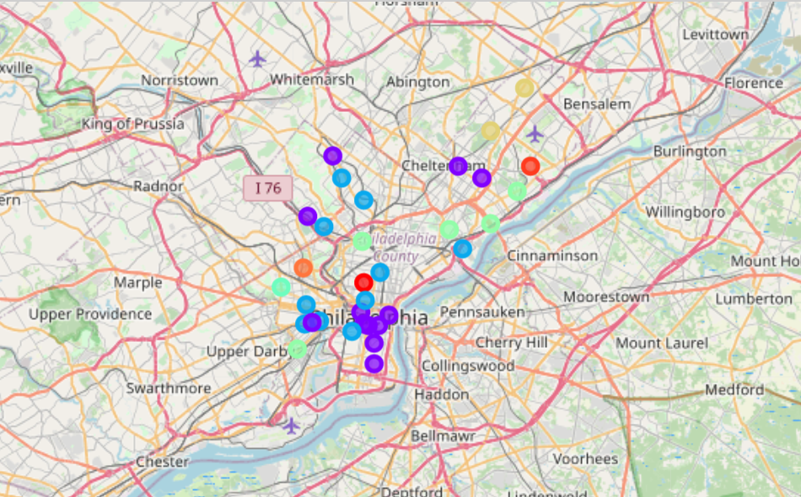
K-Means Clusters of Philadelphia Neighborhoods
Almagro falls into the purple colored cluster.

Slide 9
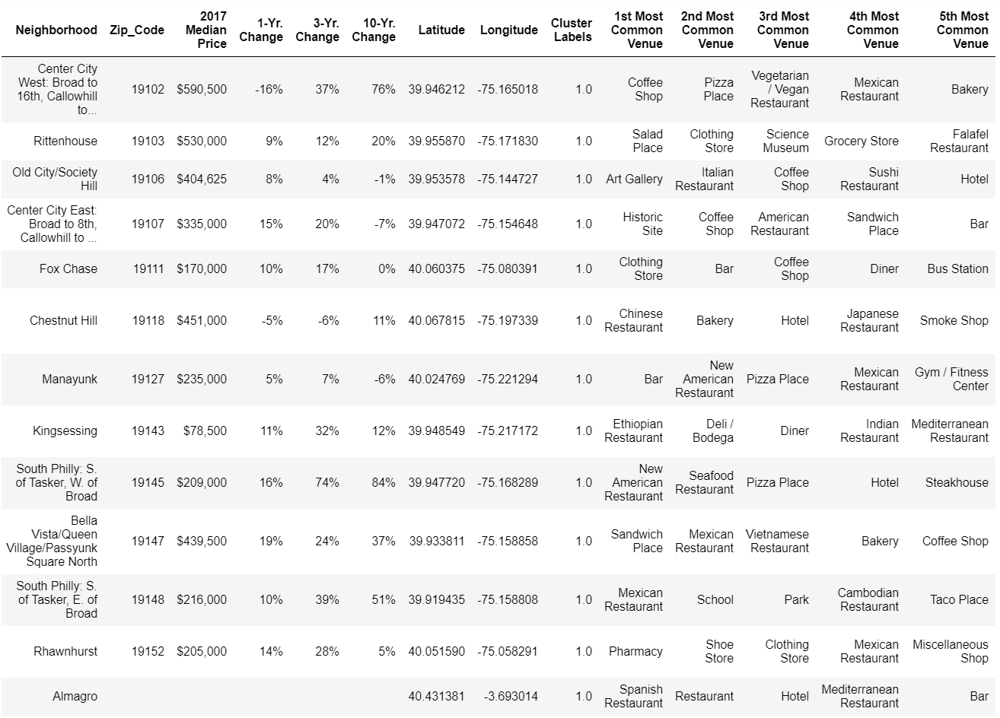
K-Means Cluster #1 – Most Similar to Almagro

Slide 10
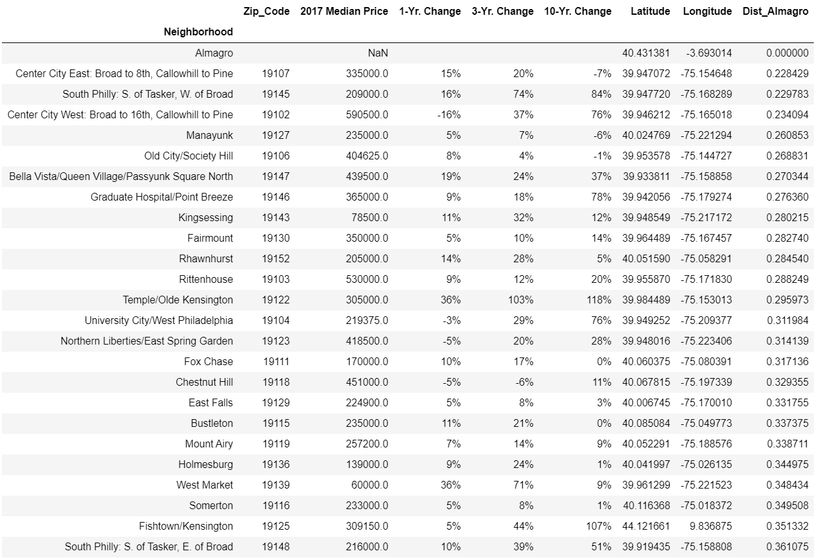
Neighborhoods Ranked by Euclidian Distance from Almagro
Most Promising Candidates

Slide 11
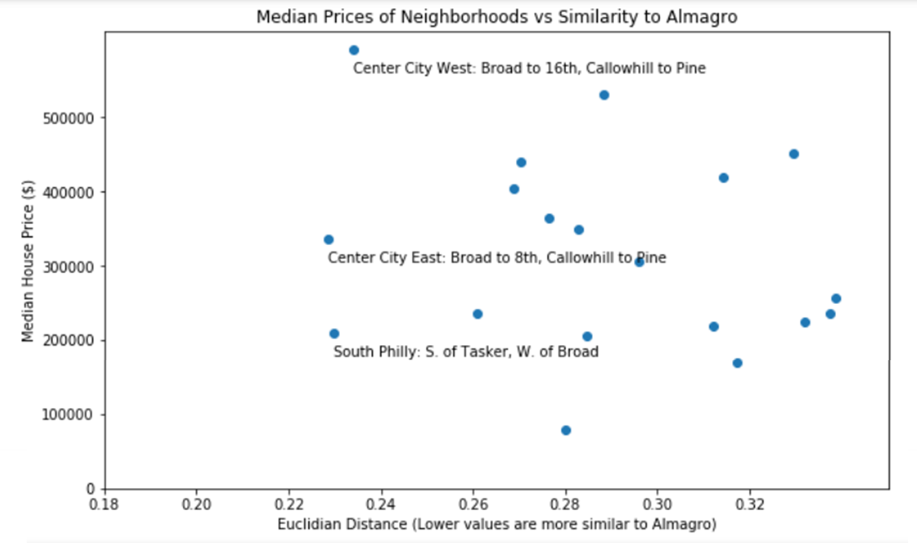
Scatter Plot of Similarity vs. Median Housing Price
Three neighborhoods are identified as promising candidates:
Center City East: Broad to 8th, Callowhill to Pine
South Philly: S. of Tasker, W. of Broad, and
Center City West: Broad to 16th, Callowhill to Pine.
Of these neighborhoods, South Philly is clearly the most affordable, with a median house price of $209,000.

Slide 12
Conclusions
An effective algorithm has been developed for identifying neighborhoods in a selected city that are most similar to some desirable neighborhood in another city.
The algorithm utilizes k-means clustering to find groups of similar and dissimilar neighborhoods, and then identifies the most similar neighborhoods by calculating Euclidian distance from the target neighborhood in the multidimensional space.
Finally, the housing price statistics are incorporated in the analysis to identify neighborhoods that might be more affordable for the user, yet still relatively similar to the target neighborhood.
When applied for finding a neighborhood in the city of Philadelphia, Pennsylvania, USA that is most similar to Almagro in Madrid, Spain, three neighborhoods are identified as promising candidates:
Center City East: Broad to 8th, Callowhill to Pine
South Philly: S. of Tasker, W. of Broad
Center City West: Broad to 16th, Callowhill to Pine.
Of these neighborhoods, South Philly is clearly the most affordable, with a median house price of $209,000.

